Slide 1
Preparing for Success at Career Fair
Presented by Emet Anceaume

Slide 2
Objectives
How to successfully prepare for career fair before, during, and after the event
Identify items (such as resumes, CVs, prepared questions, company research, etc.) that one should bring to the event
Understand the importance of personal appearance with regard to making first impressions
Common mistakes to avoid
Employ different research tools to investigate potential employers of interest

Slide 3
Why Attend Career Fair?
To meet and network with company representatives-in person
Learn more about companies
Explore possible career options
Potentially secure an internship/job!

Slide 4
Before Career Fair

Slide 5
Preparation is Success
Know your objectives & purpose
Identify your skills and strengths and think of
examples to demonstrate them
Practice your answers to common questions:
“What are you looking for at the job fair?”
“Tell me about yourself.”
“Why are you interested in Company X?”
“What makes you a fit for this position?”
“What set of skills make you stand?”

Slide 6
“Elevator Pitch”: Your Introduction
Short but impressive and confident introduction
May be tailored to the company of interest
Includes some of the following:
Name
Year in school and/or when expected to graduate
What type of employment/position you are looking for
Strongest skills, accomplishments and/or unique contributions you will bring
Why this matters to the company of interest
www.sc.edu/career

Slide 7
Preparing Resumes, CVs, and other materials
Bring many copies of your CV or resume
If you are interviewing, bring 3 copies for each scheduled interview in case you’re interviewing with more than one person
If you’re just touring the Career Fair – bring 12 to 15 copies in case you want to leave one with a potential employer
If you have business cards, you may also leave them with employers of interest or other networking leads

Slide 8
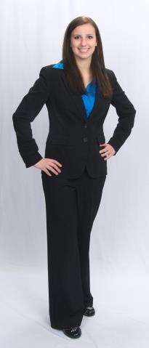
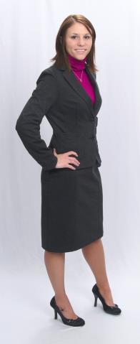
Dressing for Success…NOT the Clubs!
YES
NO
www.samanthaonstyle.com

Slide 9
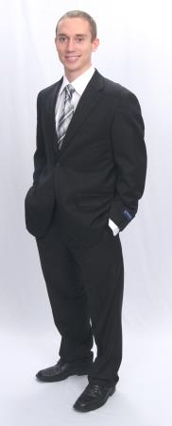
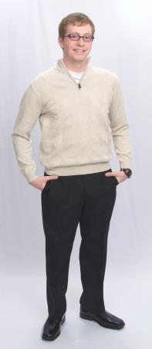
Dressing for Success…NOT the Clubs!
YES
NO

Slide 10
During Career Fair

Slide 11
What to Do…
Arrive early and give yourself enough time to not rush
Dress and act professionally
Remember your body language
LISTEN to the employer
Do not ramble
Speak clearly and keep an open mind when talking with employers
Ask questions
Network with employers and other students
Wear comfortable shoes (appropriate)

Slide 12
What to Do…(cont.)
Wear a name tag, if you have one
Gather literature and freebies BUT don’t be a freebies hog
Carry your resumes/CVs in a folder along with a pen and a note pad
Request business cards and take notes
Avoid bringing bulky bags/backpacks

Slide 13
What NOT to do…
Lack focus: Giving a perception of not knowing what type of position you are seeking
Using phrases such as: “I’ll take anything” or answering “I don’t know” when asked about interests
Dress unprofessionally
Fail to bring CVs/resumes
Lack knowledge of the organization or confuse the organization with a competitor
Lack enthusiasm or interest in the organization or job opportunities
Ask about salary right away

Slide 14
After Career Fair

Slide 15
Be patient and Get Organized
Don’t expect an immediate response
Organize notes, company literature, and business cards
Prioritize contact information
Follow up if you need to in a timely manner
Mail hand written “Thank you” cards and include your business card if you have one

Slide 16
Resources Available

Slide 17
Need help?
Career Services
http://pharmacy.ufl.edu/education/student-affairs/careers-in-pharmacy/
If you need assistance with your CV or resume, please reach out to our dedicated College of Pharmacy Liaison
Eirini Chaddon, eirinic@crc.ufl.edu
For peer support
Emet Anceaume, e.anceaume@ufl.edu

Slide 18
Save the Date!
October 27, 2016 – Orlando (UF Research and Academic Center at Lake Nona)
October 28, 2016 – St. Petersburg (Conference Center)
November 2-3, 2016 – Gainesville (Hilton University of Florida Conference Center)
November 4, 2016 – Jacksonville (LRC Atrium)

Slide 19
GOOD LUCK!

